Slide 1

Introduce To
Fun Meeting InterActive
Friday, September 27 2019

Slide 2
Why GIT is Useful
?

Slide 3
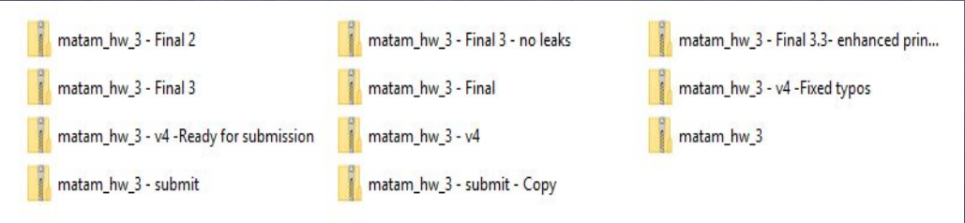
Use Cases

Slide 4
Use Cases
Consider this scenario:
You have a homework submission in Matam for today and the assignment is ready for submission
While testing it you discovered a minor bug and decided to fix it

Slide 5
Use cases
After attempting to do so, you accidentally changed a working code and got yourself in a big mess
You no longer remember what was and what wasn’t there
It is 23:58 PM

Slide 6
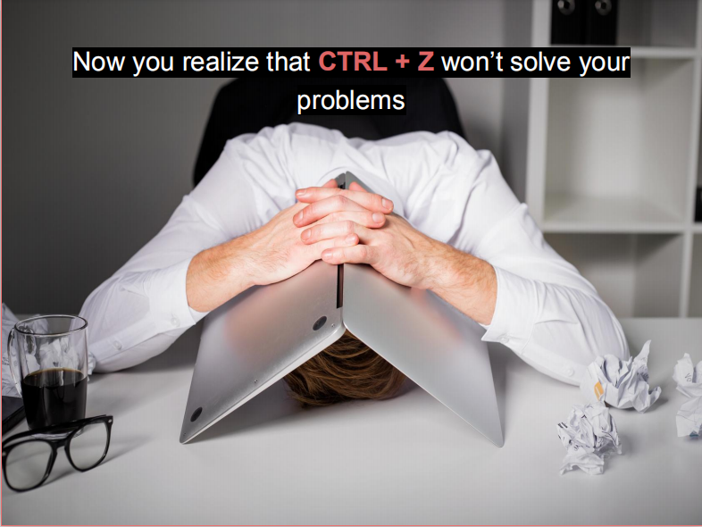

Slide 7
What is git?

Slide 8
What is git?
Open source project originally developed in 2005 by Linus Torvalds
A command line utility
You can imagine git as something that sits on top of your file system and manipulates files
A distributed version control system - DCVS

Slide 9
What is “distributed version control system” ?
Version control system is a system that records changes to a file or set of files over time so that you can recall specific versions later
Distributed means that there is no main server and all of the full history of the project is available once you cloned the project

Slide 10
A brief history
In 2002, the Linux kernel project began using a DVCS called BitKeeper
In 2005, the commercial company that developed BitKeeper broke down, and the tool’s free-of-charge status was revoked
This prompted the Linux development community (and in particular Linus Torvalds, the creator of Linux) to develop their own tool - git

Slide 11
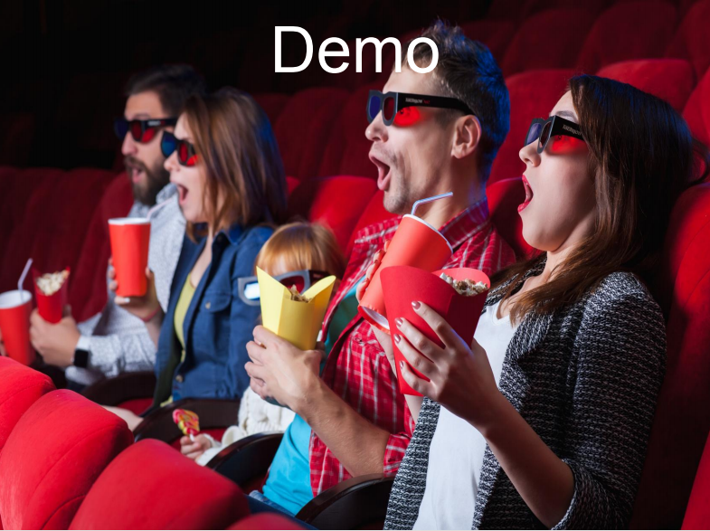

Slide 12
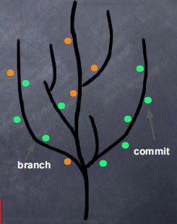
git
You can imagine git as something that sits on top of your file system and manipulates files
This “something” is a tree structure where each commit creates a new node in that tree
Nearly all git commands actually serve to navigate on this tree and to manipulate it accordingly

Slide 13
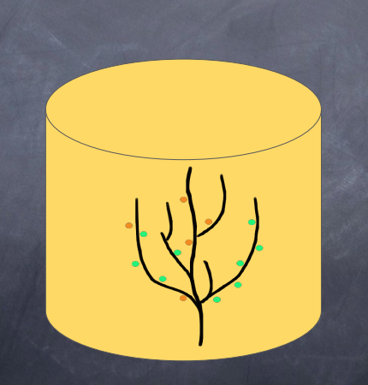
git repository

Slide 14
git repository
The purpose of git is to manage a project, or a set of files, as they change over time. Git stores this information in a data structure called a repository
A git repository contains, mainly:
A set of commits

Slide 15
Commit
A commit object mainly contains three things:
A set of changes the commit introduces
Commit message describing the changes
A hash, a 40-character string that uniquely identifies

Slide 16
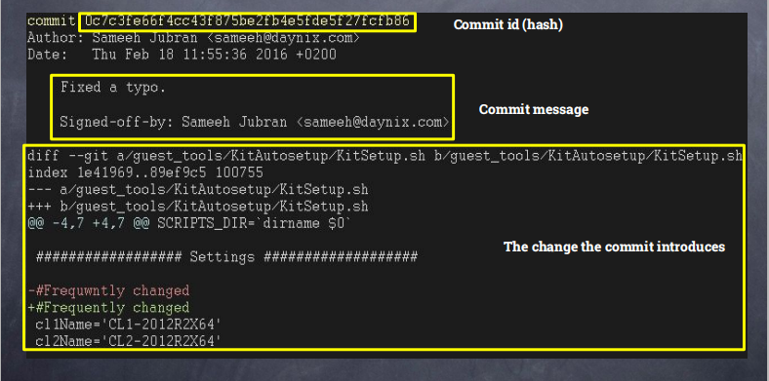
Commit

Slide 17
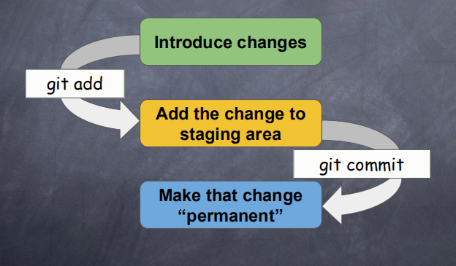
git workflow
How commits are created?

Slide 18
Three Step Of Commit
Introduce a change: introduce a change to a file that is being tracked by git
Three type of change are : add new file, edited file, and deleted file
Add the actual change to staging area: Add the change you actually want using “git add”
Commit: Commit the change that has been added using git commit

Slide 19
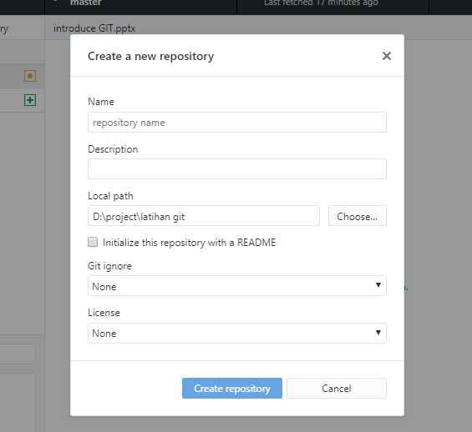
git init
Creates a new git repository
Can be used to convert an existing, unversioned project to a git repository or initialize a new empty repository

Slide 20
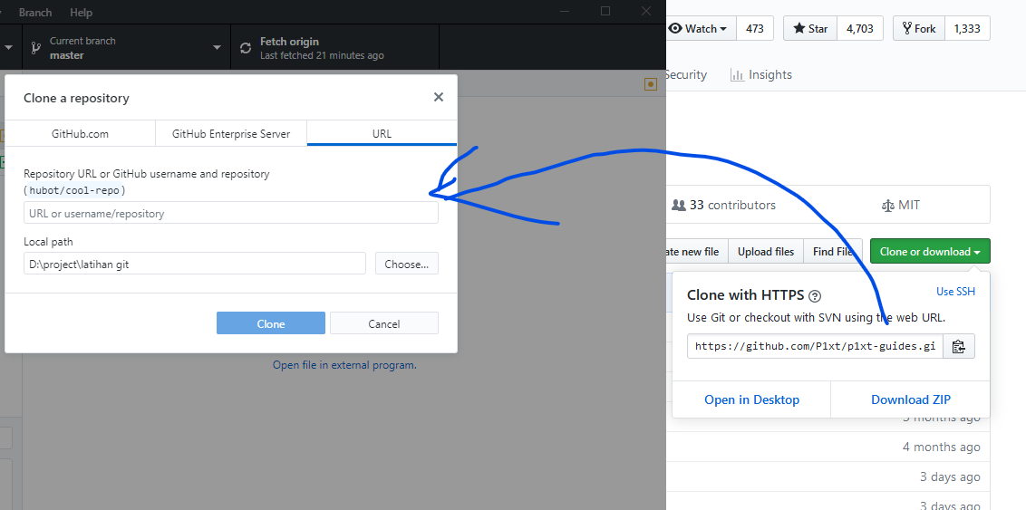
git clone
Copies an existing git repository, usually from cloud to client

Slide 21
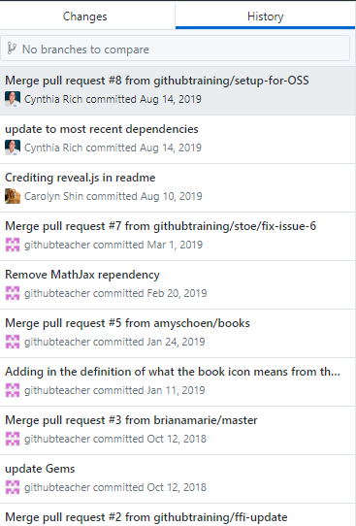
git log
Shows the commit logs

Slide 22
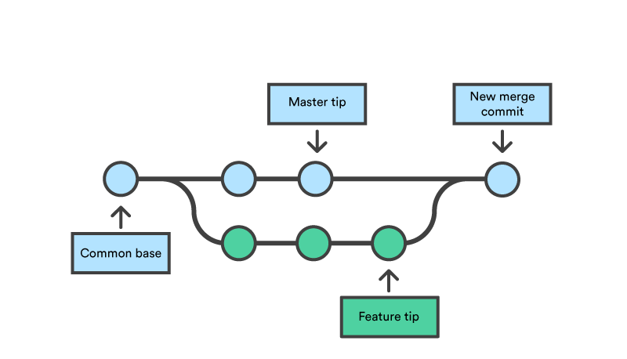
Branch
A branch in Git is simply a lightweight movable pointer to one of these commits. The default branch name in Git is master .

Slide 23
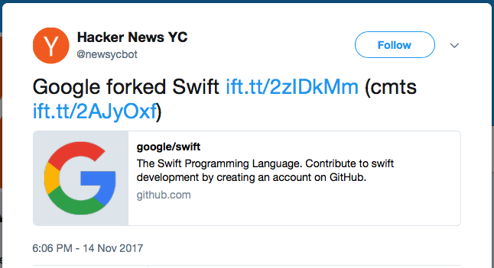
Git Fork
Fork means copying a project, changing its name, and creating a project and community with copies.

Slide 24




git fork
There have been many forks that have taken place in the history of free and open source software. Some of the biggest ones are forking MariaDB from MySQL, NextCloud from OwnCloud, and Jenkins from Hudson.

Slide 25

github

Slide 26
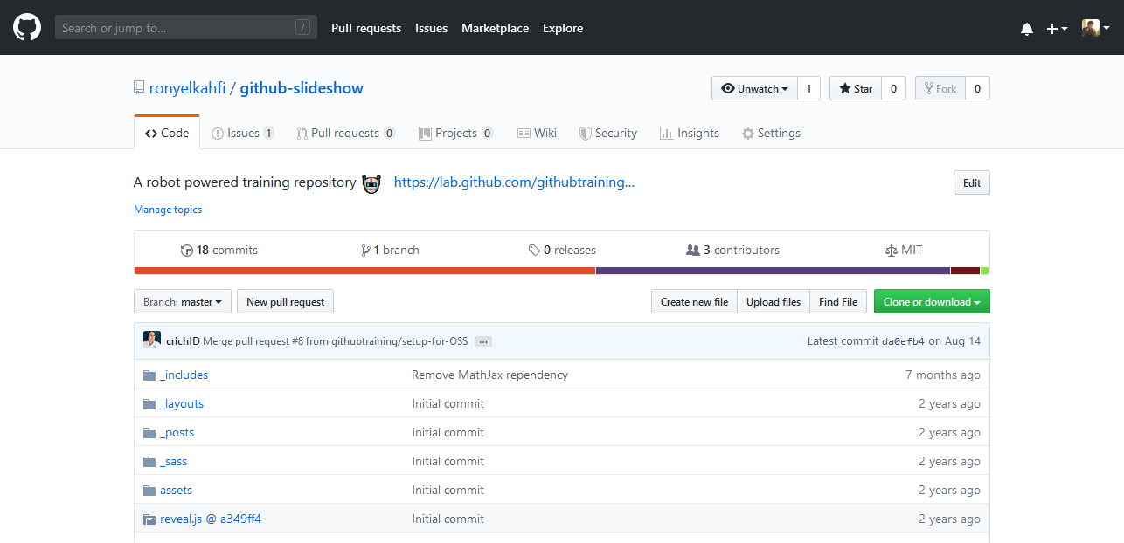
Github
GitHub is a web-based Git repository hosting service

Slide 27
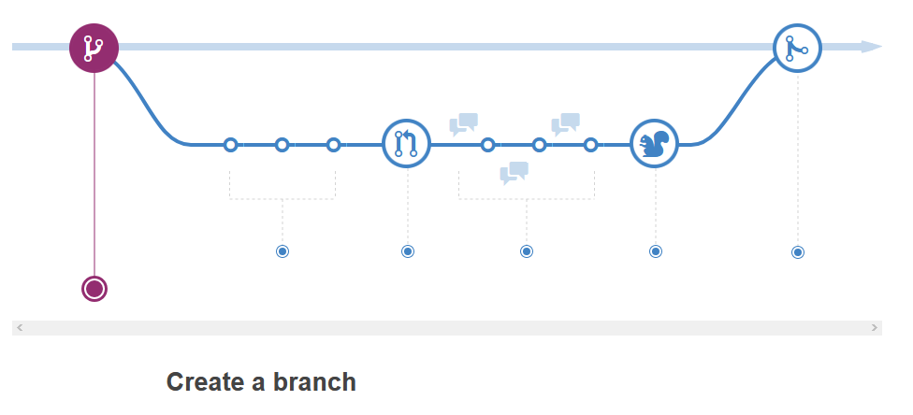
github workflow

Slide 28
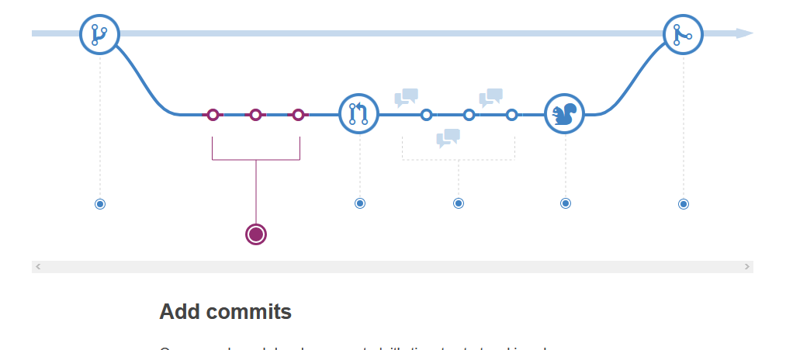
github workflow

Slide 29
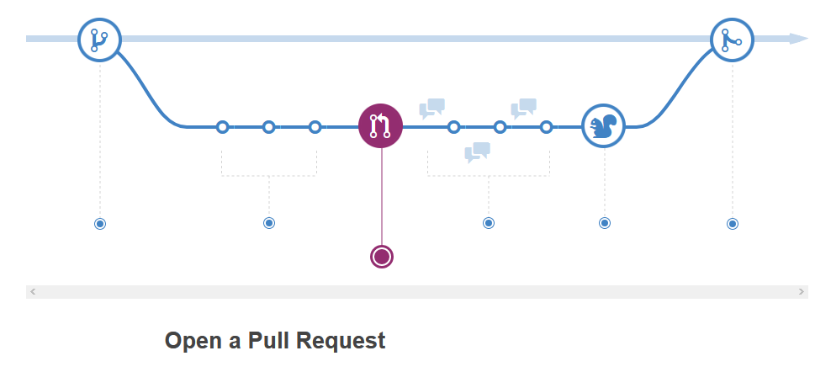
github workflow
https://guides.github.com/

Slide 30
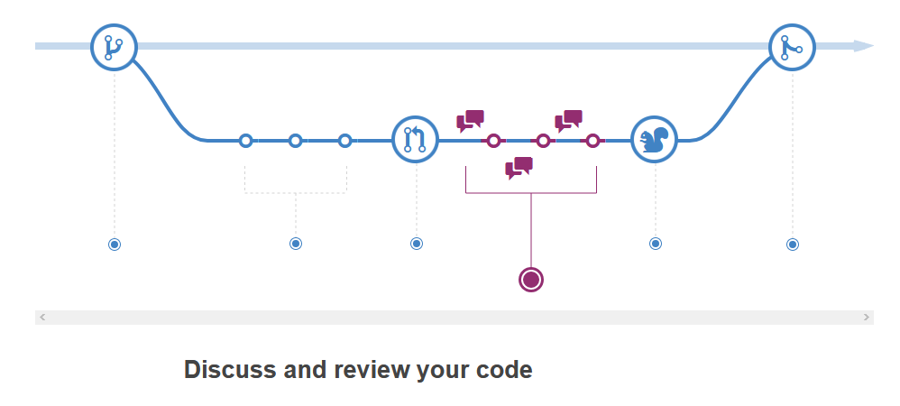
github workflow
https://guides.github.com/

Slide 31
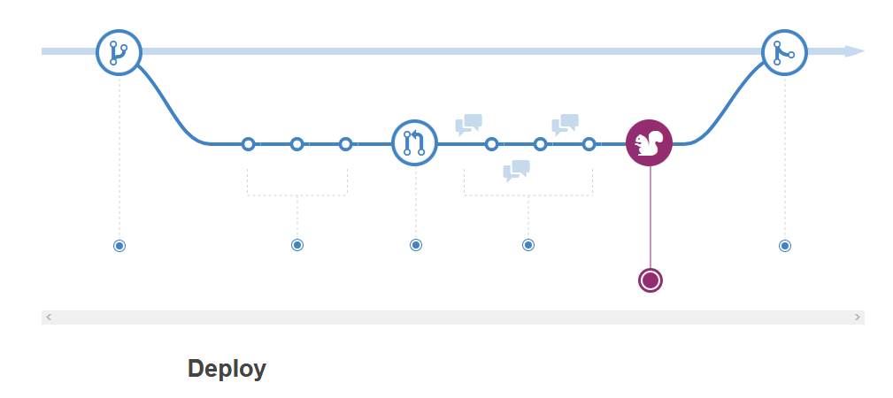
github workflow
https://guides.github.com/

Slide 32
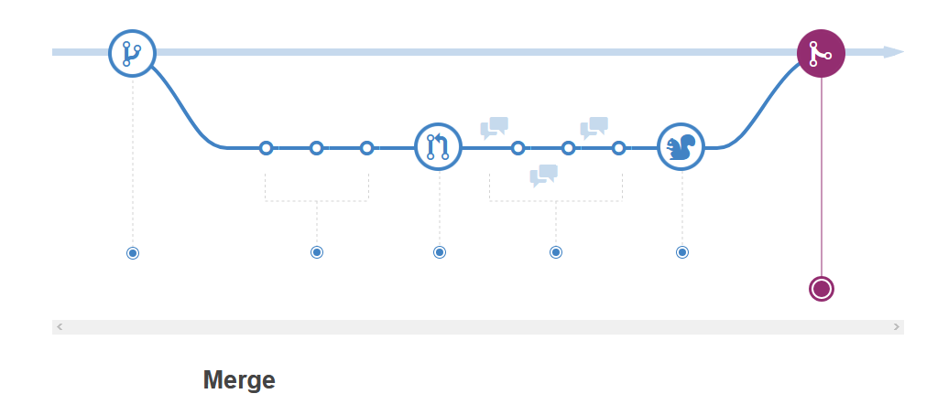
github workflow
https://guides.github.com/

Slide 33
DEMO

Slide 34
THANK YOU FOR WATCHING

